Slide 1
Artic Air
Airline Safety Research
For Senior Leadership - Not for external use
DSC 640 - Spring
Rodrigo Ivan Rodriguez
Assignment 3.3 Project Task 2

Slide 2
Agenda
Introduction
Visual 1 – How airline safety is trending
Visual 2 – Fatal accidents, then vs. now
Visual 3 – More flights equals more risk
Visual 4 – Airlines leading the panic
Visual 5 & 6 – U.S. compared to the rest of the world
Conclusion

Slide 3
Introduction
Airline safety has improved across the industry.
The following visuals will highlight the key datapoints that reveal the true improvements of airline safety.
Additionally, the data shows how most incidents are centralized to three big airlines.
Lastly, we will show how overall U.S. airlines only account for a small percentage of the total world fatalities.

Slide 4
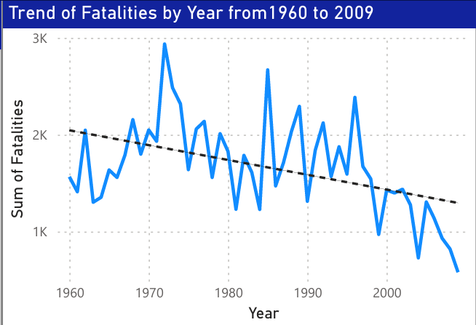
How airline safety is trending (Airline safety is improving)
Contrary to what the media portrays, fatal accidents have been decreasing over time.
While there are year-to-year fluctuations, the overall trend signifies improvement.
Effective improvements took place post 1980’s leading to improved safety.

Slide 5
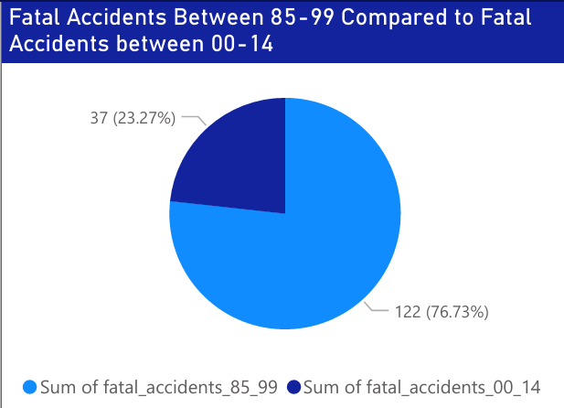
Fatal Accidents, then vs. now (70% reduction)
Fatal accidents have dropped from the recent spike the years 1985-1999
Safety and quality measures across the airline industry resulted in a 70% reduction in fatal accidents from the year 2000 onwards.

Slide 6
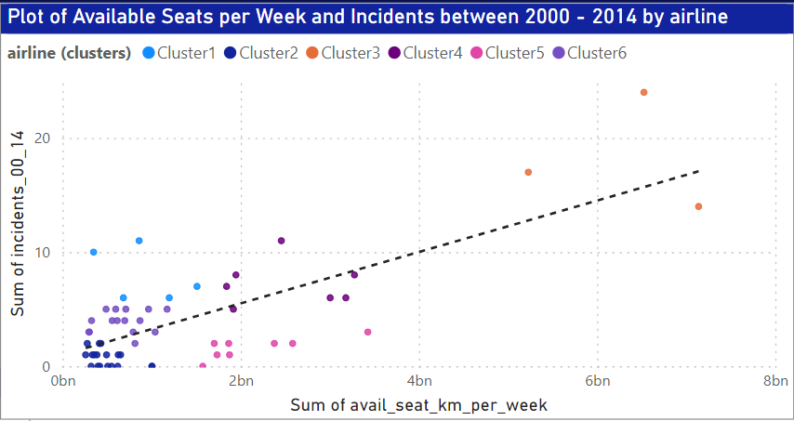
More flights equal more risks (Bulk of incidents isolated to 3 airlines)
Available seat kilometers per week is positively correlate to incidents.
Most incidents are isolated to three airlines (cluster 3)
Risk can be mitigated as seen by airlines with high available kilometers and low incidents (cluster 5)

Slide 7
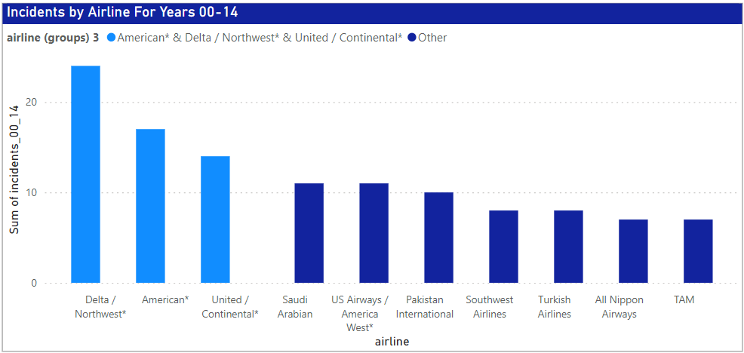
Airlines leading the panic (Big 3 have 80% more incidents)
The big three airlines are averaging 80% more incidents than the ten next high incident airlines.
Excluding Delta, American, and United, the next ten airlines with a high incident count average 10 incidents.
Delta, American, and United average 18 incidents.

Slide 8
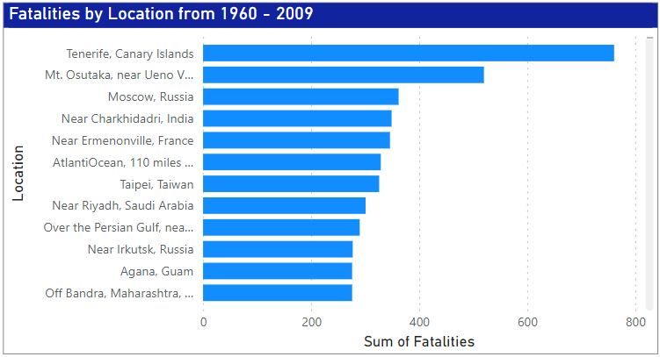
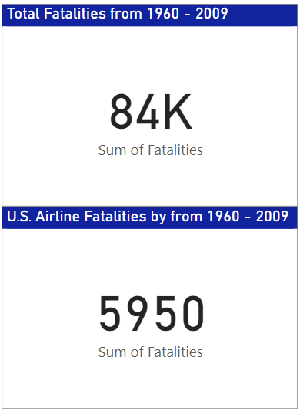
U.S. compared to the rest of the world (Non-U.S. airlines make 93% of fatalities)
The bar graph shows that the most of fatalities occur in locations outside of the U.S.
As shown by the summary cards, U.S. only accounts for 5,950 fatalities out of about 84,000, roughly 7%.

Slide 9
Final Takeaways - Conclusion
Airline safety has improved over time and trends show continued improvement.
Major airlines face more risk. Risk mitigation practices and quality improvements need to be made to minimize risk.
U.S. airlines account for a small percentage of total world fatalities with most fatalities occurring outside of the continental U.S.
Overall, the data paints a different truth to what the media is portraying. The data speaks for itself.

Slide 10
Thank you
Rodrigo Rodriguez
DSC 640 - Spring
Project Task 2
Assignment 3.3

